Slide 1


Assignment-01
CSIS 2200-007

Slide 2
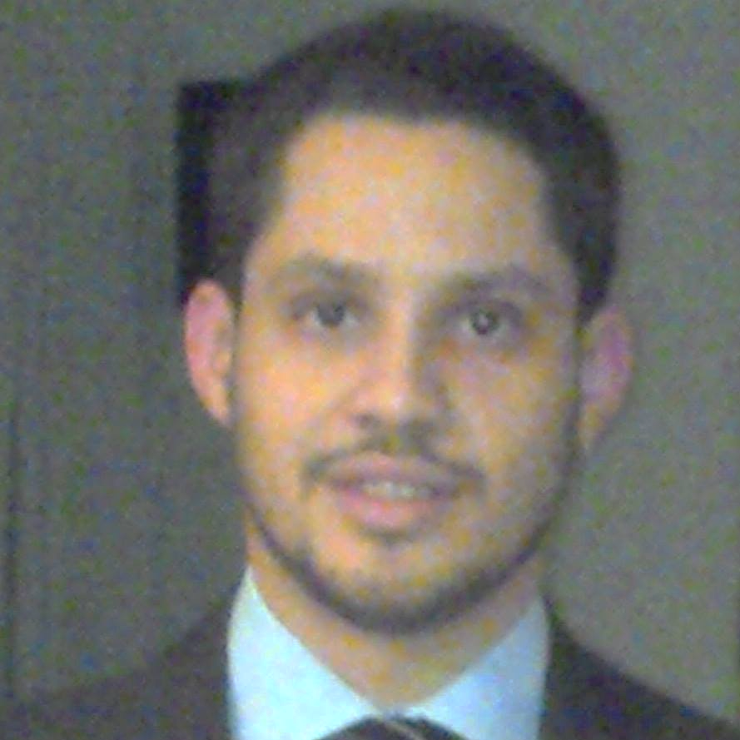
About Me
Hi there, It’s nice to have you here!
My name is Leandro Miranda Fahur Machado, and I am currently enrolled in Computer & Information Systems in the Emerging technology stream at Douglas College.

Slide 3
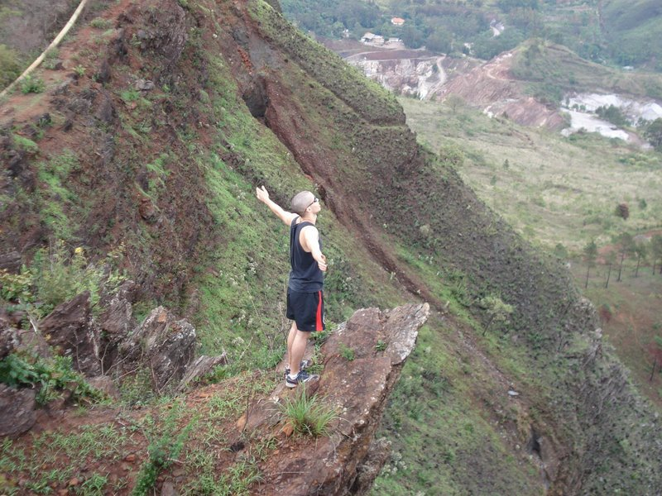
WHO AM I?
I am the youngest of three boys. Different from common belief, I am far from being the spoiled one. I cannot vouch for my other two brothers, though.
I was born in Brazil, and have a Bachelor’s degree in Control & Automation Engineering.

Slide 4
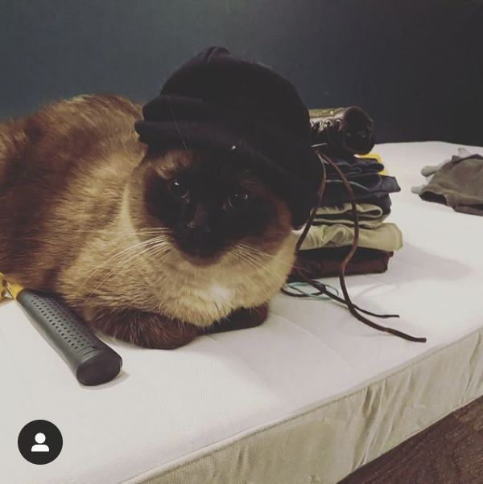
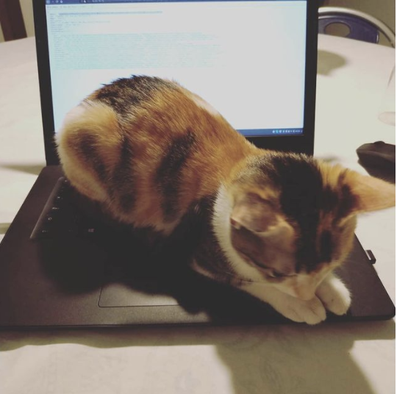
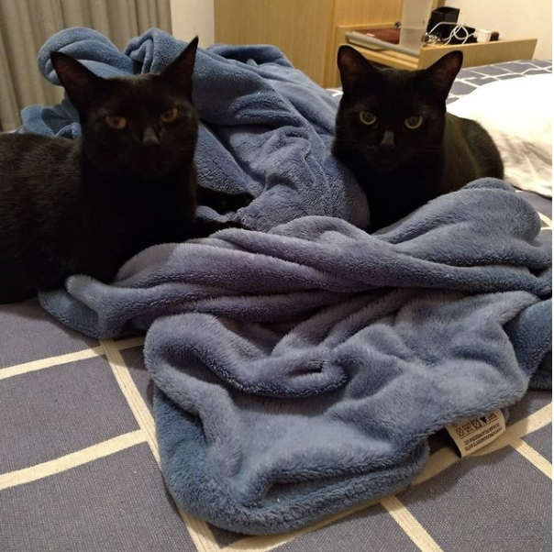
What do I love?
Stepson: Kaizer
Niece: Alice
Daugther’s: Alana and Amora

Slide 5
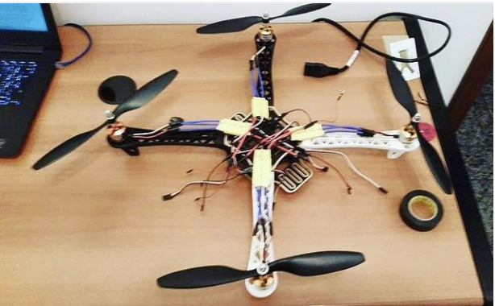
Hobbies & Interests
Robotics
Games
Teaching
Reading
Sports
Cats

Slide 6
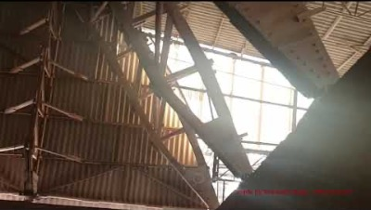
Professional

Slide 7
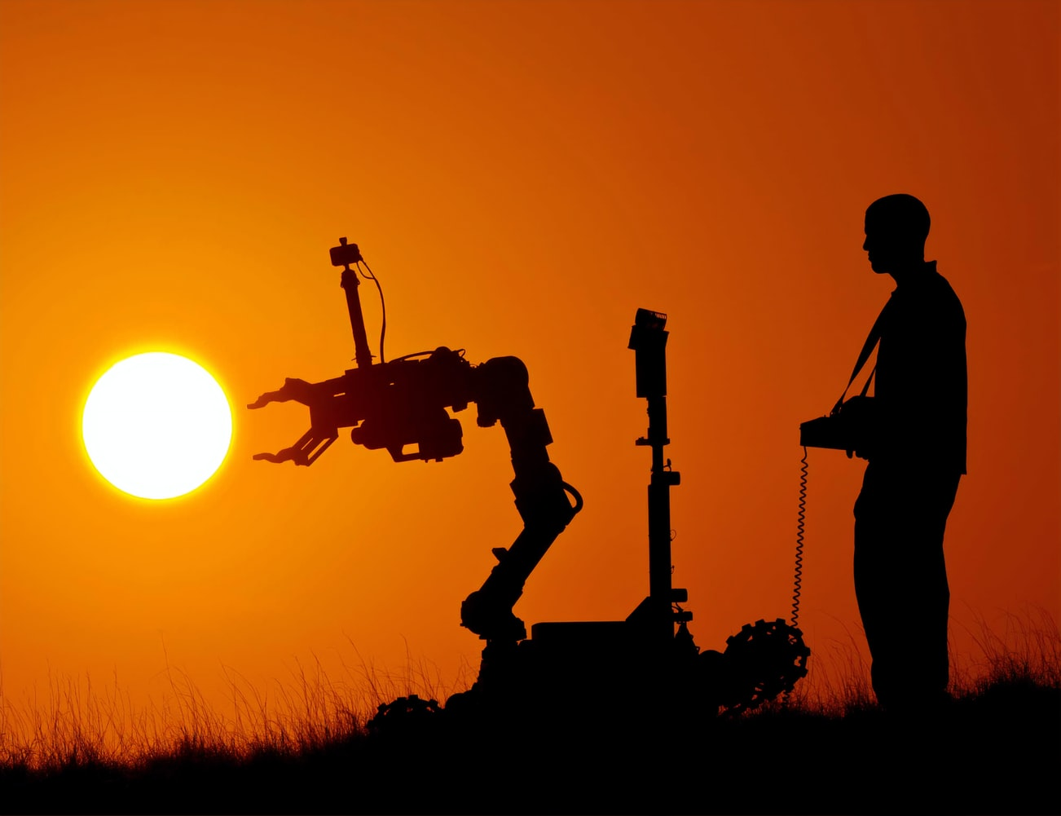
Career Goals
I have divided my career goals in short-term and long-term:
Work with my passion!
Develop new skills and refine existing ones.
Transform my experience into a business.

Slide 8
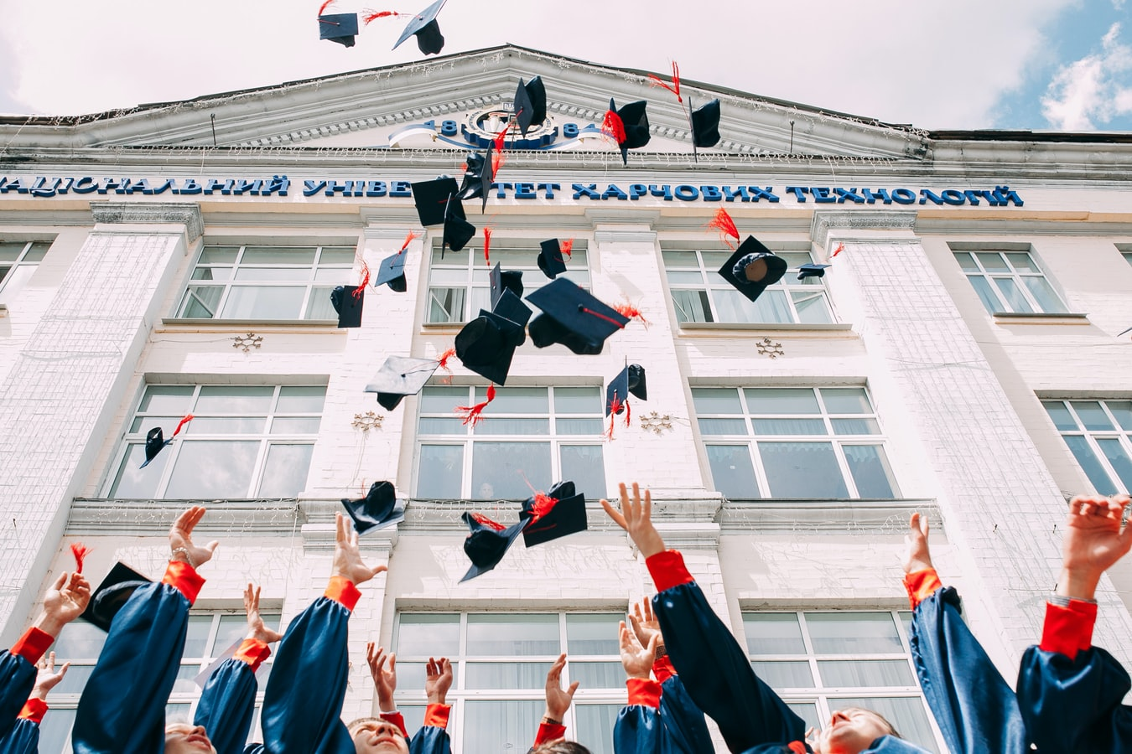
EDUCATION
Graduate from Douglas College
Pursue a Master Degree in CS.
PhD. in Computer Science

Slide 9
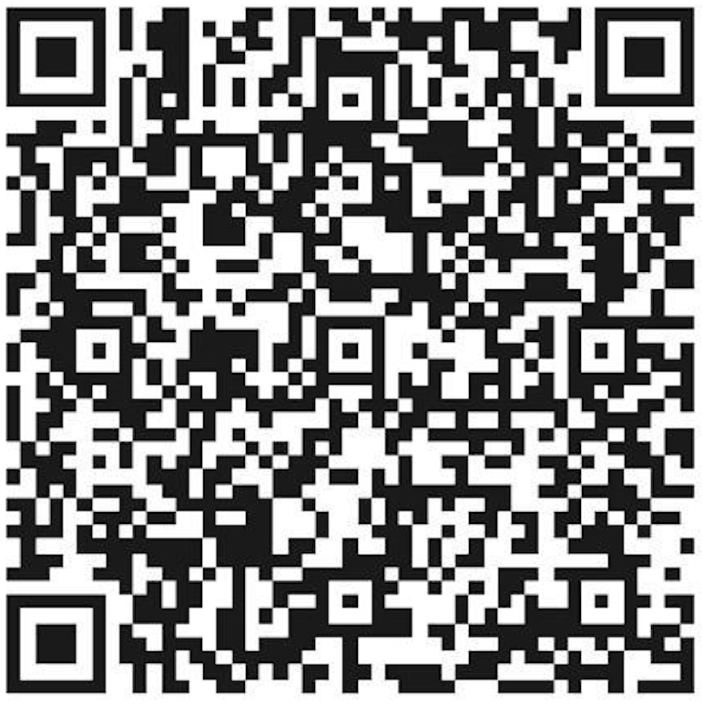
Contact Me

Slide 10
Thank you
CSIS 2200-007

